Slide 1

Chapter 10

Slide 2
Approaches to System Development
Chapter 10
Systems Analysis and Design in a Changing World 6th Ed
Satzinger, Jackson & Burd

Slide 3
Overview
Chapter 1 demonstrated a system development project that used an iterative and agile system development life cycle (SDLC)
Later chapters focused on Systems Analysis activities and tasks and some System Design activities and tasks
Now we return to look at the SDLC and related concepts in more detail
Predictive versus Adaptive SDLC variations
Activities and Tasks of System Support
Models, Methodologies, Tools and Techniques
Agile Development
Specific SDLC Approaches
Unified Process (UP)
Extreme Programming (XP)
Scrum

Slide 4
The System Development Life Cycle (SDLC)
There are two general approaches to the SDLC
Predictive Approach to the SDLC
Waterfall model
Assumes the project can be planned in advance and that the information system can be developed according to the plan
Requirements are well understood and/or low technical risk
Adaptive Approach to the SDLC
Iterative model (as see in this text)
Assumes the project must be more flexible and adapt to changing needs as the project progresses
Requirements and needs are uncertain and/or high technical risk

Slide 5
The System Development Life Cycle (SDLC)
Most projects fall on a continuum between Predictive and Adaptive

Slide 6
Traditional Predictive SDLC
Earlier approach based on engineering
Typically have sequential Phases
Phases are related groups of development activities, such as planning, analysis, design, implementation, and deployment
Waterfall model
SDLC that assumes phases can be completed sequentially with no overlap or iteration
Once one phase is completed, you fall over the waterfall to the next phase, no going back

Slide 7
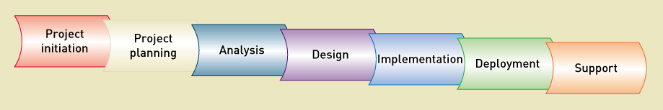
Tradition IS Development Phases

Slide 8
Waterfall Predictive SDLC

Slide 9
Modified Waterfall with Overlapping Phases
More flexibility, but still assumes predictive planning and sequential phases

Slide 10
Newer Adaptive SDLC
Emerged in response to increasingly complex requirements and uncertain technological environments
Always includes iterations where some of design and implementation is done from the beginning
Many developers claim it is the only way to develop information systems
Many IS managers are still sceptical due to apparent lack of overall plan

Slide 11
Adaptive Approaches
Incremental development
Completes portions of the system in small increments and integrated as the project progresses
Sometimes considered “growing” a system
Walking Skeleton
The complete system structure is built first, but with bare-bones functionality

Slide 12
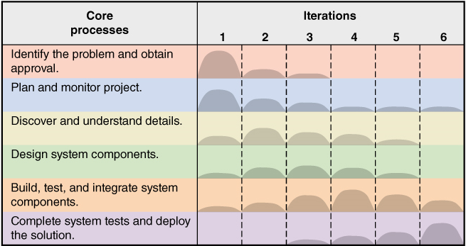
A Generic Adaptive Approach
Six Core Processes go across iterations
Multiple Iterations as required

Slide 13
Methodologies, Models, Tools, and Techniques
Methodologies
Provides guidelines for every facet of system development: What to do when, why and how
Specifies an SDLC with activities and tasks
Specifies project planning and project management models and reporting
Specifies analysis and design models to create
Specifies implementation and testing techniques
Specifies deployment and support techniques
Other term used is System Development Process

Slide 14
Methodologies
A Methodology includes a collection of techniques that are used to complete activities and tasks, including modeling, for every aspect of the project

Slide 15
Methodologies, Models, Tools, and Techniques
Model
An abstraction of an important aspect of the real world.
Makes it possible to understand a complex concept by focusing only on a relevant part
Each model shows a different aspect of the concept
Crucial for communicating project information
In IS, some models are of system components that will be developed
Other models are used to manage the development process

Slide 16
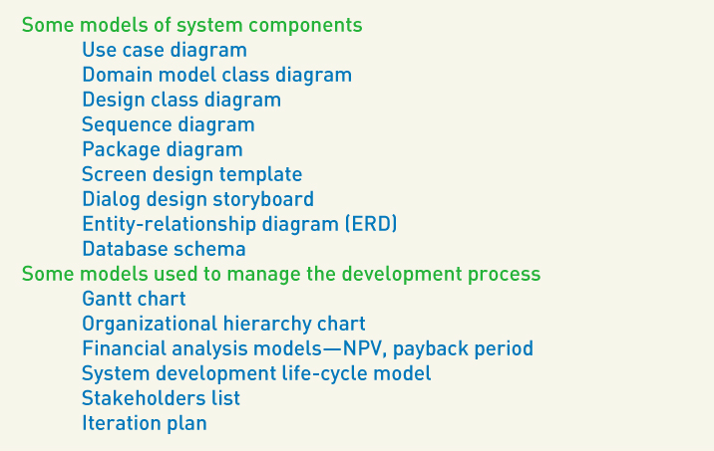
Methodologies, Models, Tools, and Techniques

Slide 17
Methodologies, Models, Tools, and Techniques
Tools
Software applications that assists developers in creating models or other components required for a project
Integrated Development Environment (IDE)
set of tools that work together to provide a comprehensive development environment
Visual Modeling Tools
Tools to create graphical models

Slide 18
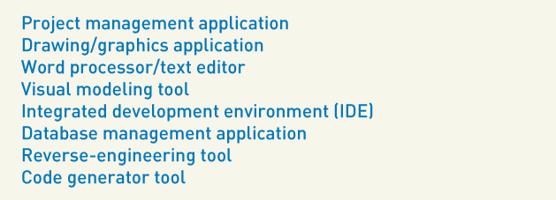
Methodologies, Models, Tools, and Techniques
Some typical tools

Slide 19
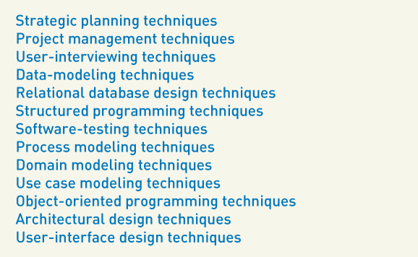
Methodologies, Models, Tools, and Techniques
Technique
A collection of guidelines that help an analyst complete an activity or task
Learning techniques is the key to having expertise in a field

Slide 20
Agile Development
A guiding philosophy and set of guidelines for developing information systems in an unknown, rapidly changing environment
Chaordic
A term for adaptive projects – chaotic yet ordered

Slide 21
Agile Development
Agile Values in “Manifesto for Agile Software Development”
Value responding to change over following a plan
Value individuals and interactions over processes and tools
Value working software over comprehensive documentation
Value customer collaboration over contract negotiation

Slide 22
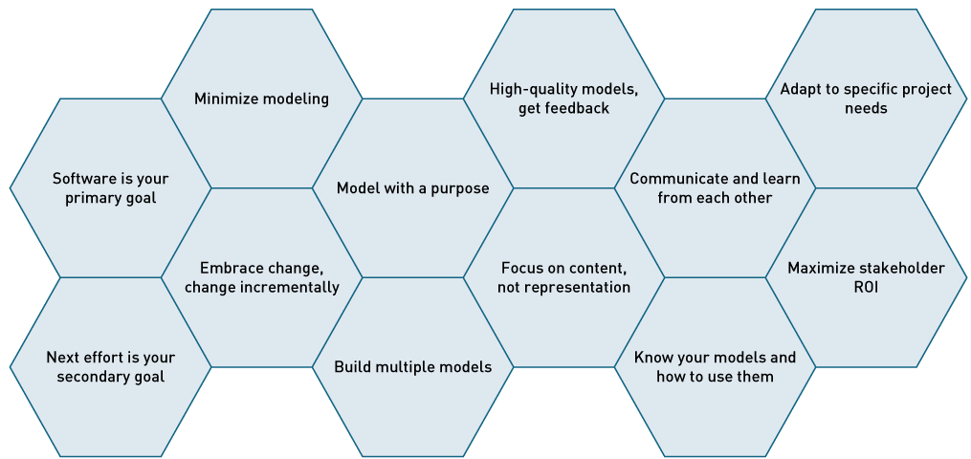
Agile Modeling Principles
Agile Modeling (AM) – 12 Principles
A philosophy – build only necessary models that are useful and at the right level of detail

Slide 23
Agile Principles
Develop software as the primary goal
Don’t get distracted by documentation or models
Enable the next effort as your secondary goal
Be aware of next step versions or revisions
Minimize your modeling activity
Only build what helps move the project forward
Embrace change and change incrementally
Take small steps that keep you on-track and that can be reversed if necessary

Slide 24
Agile Principles
Model with a purpose
Model to understand
Model to communicate
Build multiple models
Look at problems from different perspectives
Build high-quality models and get feedback
Focus on content rather than representation
Informal hand-drawn models are sometimes okay
Always focus on stakeholder needs

Slide 25
Agile Principles
Learn from each other with open communication
Know your models and how to use them
Adapt to specific project needs
Maximize stakeholder RMI

Slide 26
The Unified Process (UP)
The UP was the early leader in adaptive approaches
UP and UML (Unified Modeling Language) were developed together

Slide 27
The Unified Process (UP) – Phases
UP Phases organize iterations into four primary areas of focus during a project
Inception phase – getting the project started
Elaboration – understanding the system requirements
Construction – building the system
Transitions – preparing for and moving to deploying the new system

Slide 28
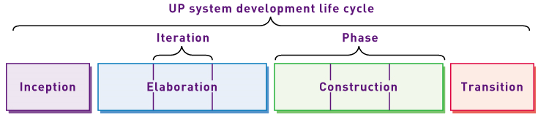
Unified Process (UP) – Phases
UP SDLC divides iterations into four phases

Slide 29
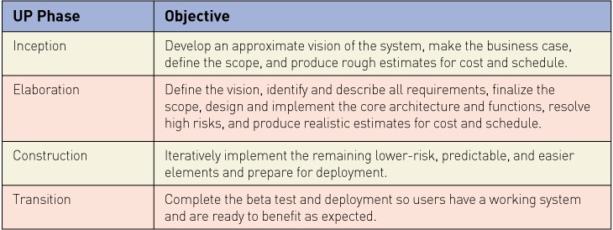
Unified Process (UP) – Phases
Objectives of each phase

Slide 30
Unified Process – Disciplines
A set of functionally related development activities
Each discipline are all the activities related to achieving one objective in the development project
Two types of disciplines
Development disciplines
Management – planning and control disciplines

Slide 31
Unified Process – Disciplines
Development Disciplines
Business modeling
Requirements
Design
Implementation
Testing
Deployment

Slide 32
Unified Process – Disciplines
Planning and Control disciplines
Configuration and change management
Project management
Environment

Slide 33
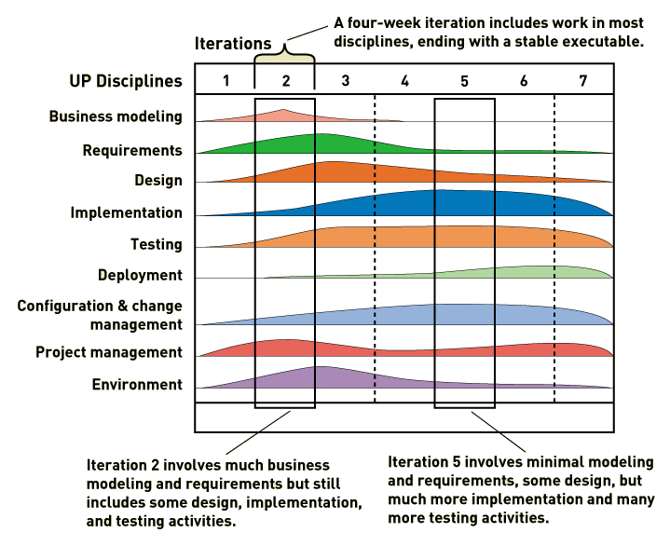
Unified Process – Disciplines
Disciplines are used across all iterations

Slide 34
Extreme Programming (XP)
Takes the best practices of software development and extends them “to the extreme”
Focus intensely on proven industry practices
Combine them in unique ways to get better results
XP Core Values
Communication
Simplicity
Feedback
Courage

Slide 35
Extreme Programming (XP)
XP Practices
Planning – based on user stories
Testing – thorough testing at every step
Pair Programming – watch, inspect, trade off
Simple Designs – Agile modeling principles
Refactoring – redo and cleanup as you go
Owning the code collectively – egoless development, anyone can review and improve code

Slide 36
Extreme Programming (XP)
XP Practices (cont)
Continuous integration – grow the software continuously
On-site customer – get sign-off as you go
System metaphor – what should the final system look like
Small releases – turn over to user frequently
Forty-hour work week – don’t overload the developers
Coding standards – follow standards for code

Slide 37
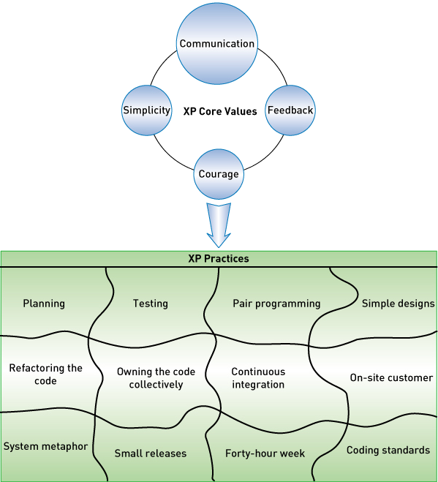
XP Core Values and Practices

Slide 38
XP Project Approach
Three level approach (three rings)
Outside ring – create user stories and define acceptance tests
Middle ring – conduct tests and do overall planning
Inside ring – iterations of coding and testing

Slide 39
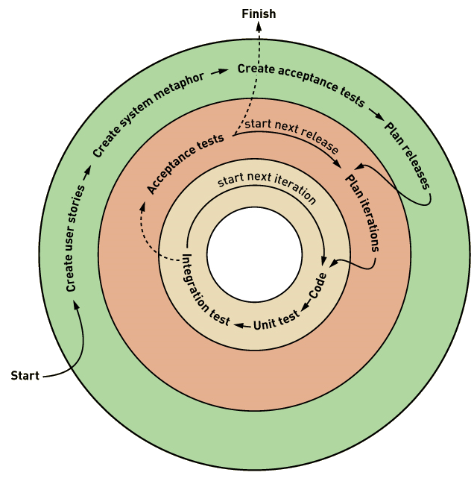
XP Project Approach

Slide 40
SCRUM
Combination of principles of Rugby and Agile
Intense effort involving the entire team for a defined period of time
Product backlog
Prioritized list of user requirements
Product owner
The client stakeholder who controls backlog
Scrum master
Scrum project manager

Slide 41
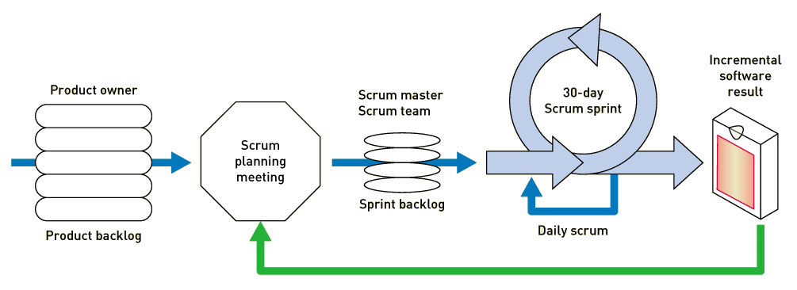
Scrum Sprint
Scrum sprint
A time-controlled mini-project to implement part of the system

Slide 42
Scrum Practices
Scope of each sprint is frozen (but can be reduced if necessary)
Time period is kept constant
Daily Scrum meeting
What have you done since the last daily Scrum (during the last 24 hours)?
What will you do by the next daily Scrum?
What kept you or is keeping you from completing your work?

